Slide 1
Personal selling in the Travel Industry
WITH Andre moten MBA

Slide 2
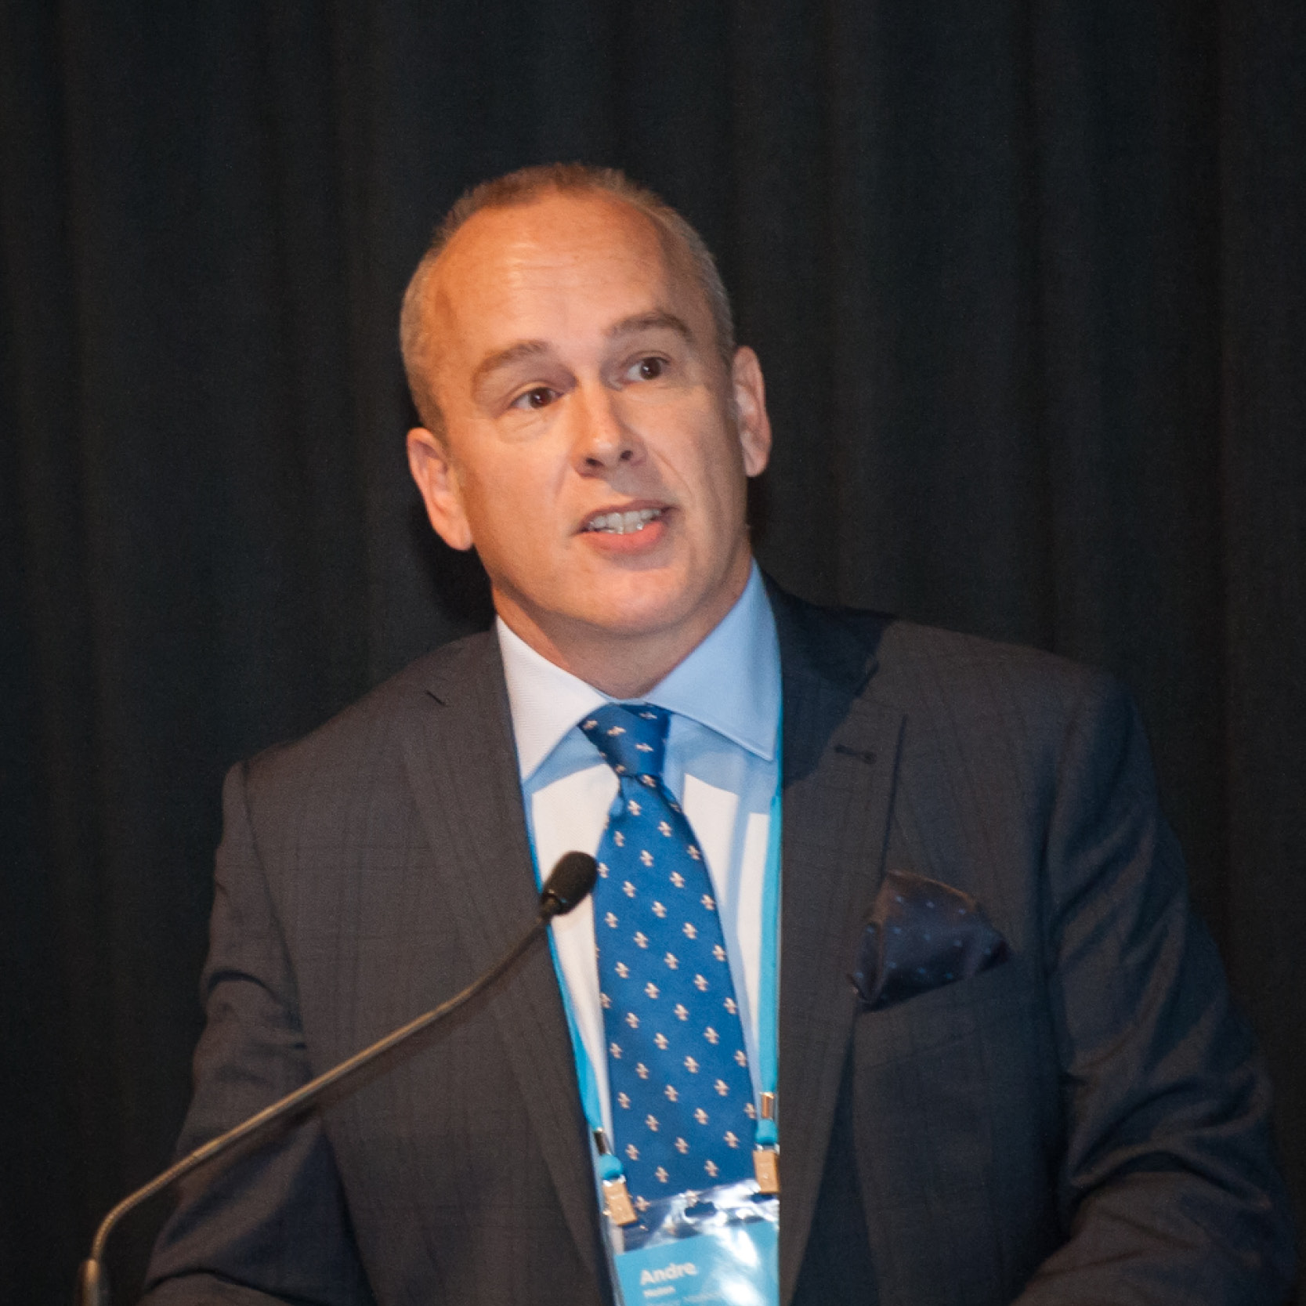
“Personal selling… When two-way communication is required to effect a sale – B2B & B2C.” √ $2b in economic impact from the staging of the Sydney Olympics….in QLD! √ Pivotal to taking CTM from $18m to $1.156b in 18 years in ANZ. √ Business growth/development acceleration expertise
- Andre

Slide 3
Agenda (with many ideas!)
Selling during COVID is different. It’s “depressed”.
Have and revisit your Sales Plan.
Get personal (where allowed).
Have more proactivity and contact points in your sales process.
Aim high in stakeholder engagement.
Map the process for the customer.
Story telling.
Build urgency.
Comparisons and contrasts.
Trials before purchase.
Negotiate!
Ask for the ‘sale’! – the difference between “selling’ and “marketing”.
Questions.

Slide 4
Revisit the Sales Plan (for COVID)
What activity levels are required to be successful, e.g. cold calls per week?
Are you measuring conversion rates, i.e. cold calls to discovery meetings?
These should be performance goals or KPIs.
Who have you targeted? Does their collective spends add up to your sales target?
Focus on the prospective customers that are continuing to buy during COVID, or have the greatest need for your products and services, e.g. could cruise ships move freight or do TMCs have medical, legal and government customers?
Where are you hunting and is it lucrative? Work collaboratively with airline reps, international affiliations, e.g. Radius, GlobalStar etc, Austrade, who needs to travel for work on Seek.com, Chambers of Commerce, exporters database, lists of high net worth individuals (BRW).

Slide 5
Get personal
Face to face beats email, texts and other electronic messaging and phone calls (in isolation).
Virtual meetings and discussions can be an alternative (especially during COVID and lockdowns!)
Remember people do business with people they know and like (and eventually trust).
You can’t always effectively provide value propositions, transactional comparisons, implementation plans or pitch presentations remotely...and accurately assess verbal and non-verbal feedback.
Just sending marketing collateral to a customer, will not necessarily convert to a sale!
Where you can… virtual live discussions definately can count. Offering the sale of a product/service with a LinkedIn invitation for connection…does not!

Slide 6
More contact points in the sales process…
What is your sales process for success? Is there a need for cold calling – discovery meetings – alignment discussions – presentations/quotations/bids – closing strategies?
Will alignment serve you to build a deeper rapport?
You should never be “awaiting a customer decision”, but rather leading them through a tried and tested sales process.
Customers are hesitant during COVID/GFC etc, given ‘tightness’ on resources and money. Multiple contact points and the ability to prescribe an agreed process is key, e.g. will a demonstration blow your competitors out of the water!

Slide 7
Aim higher in stakeholder engagement.
It is usually an error to allow prospective customers to influence/sell on our behalf internally.
You should follow the communication and be “in person” with the decision makers, e.g. partner, ELT, Board, CEO, CFO, MD, Team Manager etc to assist with the decision-making process, and to support the recommendation to use you or your service/product.
Alternatively, questions may be asked or concepts confused, and your experience and expertise would be required to resolve this. Where possible, be present for the decision making process.
Decision making has ‘centralised’ during COVID-19…

Slide 8
Map the process (for the customer).
During COVID customers need to be safely led through decision making and doubts, to progess with a sale in a timely manner!
Never leave a meeting without confirming the next action, and the timeframe involved. For example, don’t conclude a discovery meeting without agreement for a demonstration, quote, proposal or submission of further evidence to support a sale.
If you leave return contact to the discretion of the customer – they may not!

Slide 9
True story telling.
During COVID, customers will be risk averse. You need to provide evidence of low risk in your product/service, e.g. refundable and changeable terms and conditions of sale. Fee modelling with no ‘nasty surprises’ is key. All products and services that are usually considered part of the price should be.
Customers feel more trusting when they know many have gone before them. You should provide those stories, about customers buying from you during COVID, and why.
Use testimonials, online recommendations, or even encourage existing customers to communicate with prospective customers on your behalf.
Examples of story telling can be: how much business you have won from competition; your industry expertise; the awards that you have won; or the size of your portfolio.
Stories get remembered over facts, e.g. saving $600k on a $4m corporate travel expenditure to enter the resources sector.

Slide 10
Build urgency.
Can you demonstrate a desirable end state, or a return on the customer’s investment. What is the customer’s strategic objective – it may have nothing to do with travel! “I need to relax or I need more productivity” – nothing to do with $.
What is the ‘down-side’ if the customer does not choose you or your product. “For every quarter that you do not make a decision, the cost to you will be….”.
Value derived can be more important than fee charged.
Make the ‘change’ or decision to use you or your company easier – simple implementation plan. What can you take off the customer’s plate to assist choosing you.
Be prepared to negotiate. Know what your bottom-line requirements are. Do you have a cost model to work from?
Start with making sure there is clear branding and equity…and no brand confusion. “Travel ….”.

Slide 11
Comparisons and contrasts.
Be weary of providing ‘one trick pony’ solutions in your product and service suite. Customers are more likely in COVID to compare this with competitors or decide for inaction.
You should offer relevant multiple options of your product/service. This invites comparison of what you are offering in isolation. (Think corporate brands of Flight Centre.)
For example, multiple service fee models – per ticket, per booking, per transaction and/or management fee.
Offer an all inclusive or premium product/service offering, and then compartmentalized or less expensive options. This allows for contrasts of pricing points during this time of financial difficulty.
In a depressed market, customers will appreciate comparisons to support buying decisions.

Slide 12
Trials before purchase.
During COVID, expenditure budgets are likely to have been reduced in many industries, and there may be a reluctance for significant future expenditure.
‘Try before you buy’ strategies may assist. In the corporate travel and supplier space this can showcase service and value, prior to longer term commitments.
There will need to be ‘rules of engagement’:–
An agreed duration for measurement of ROI and to make it worthwhile for the vendor;
Exclusive trade during the duration of the trial – move the relationship from being ‘transactional’; and
Make sure that the payment methodology and terms are mutually beneficial.
If customers go through a trial and it is successful (service and value), you are likely to secure them long term.

Slide 13
Negotiate!
Customers will look for the best ‘deal’ they can get during COVID…this does not have to be the lowest service fee/commission.
Have a negotiation element in your value proposition, to achieve a win-win outcome. You need room to manouvre on your pricing. Some customers will expect this, and not the best deal offered first.
Plan for this. What are the “well formed outcomes” that you and the customer need?
Can getting customer employees access to a premium flight lounge membership or waiving implementation or product fees (OBT), or providing supplier inclusions alleviate price focus?
What is your ‘walk away’ point?

Slide 14
Ask for the sale!
Near the start of your sales process be clear on the decision-making criteria of the customer. It will not always just be price driven.
What exactly does it take to switch to you?
What is their process? How can you inform it? When do they have enough information to make an informed decision? (This information assists with sales and budget planning).

Slide 15
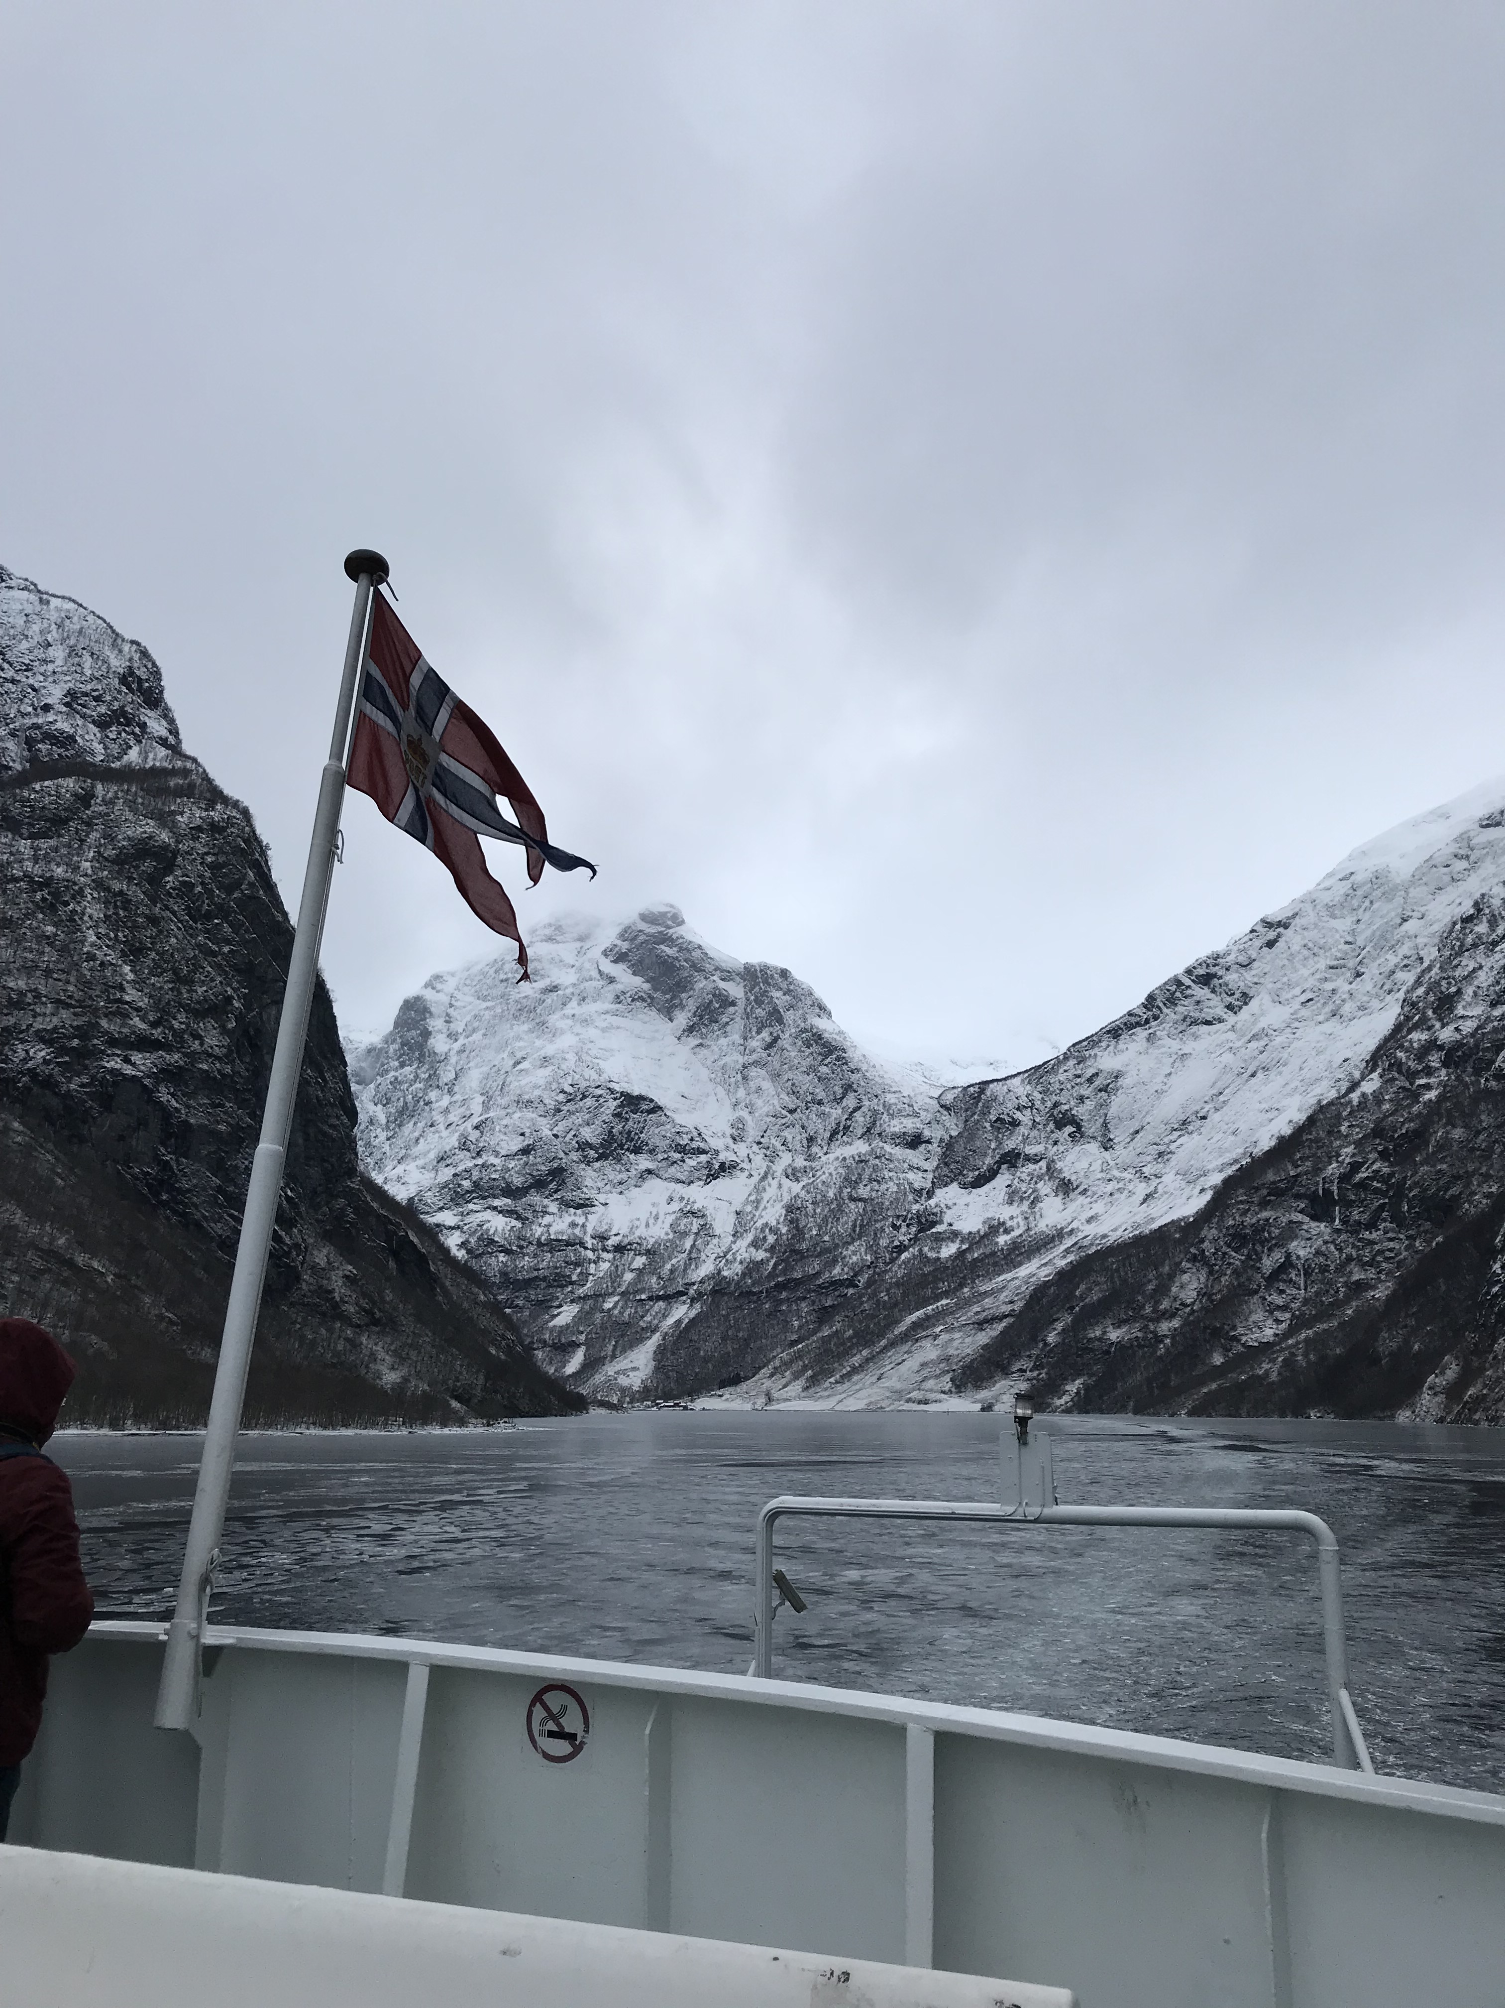
Remember borders will not stay closed forever. Congratulations on investing in your personal selling technique with TIME! Moving market share is how you get ahead of the game! Remember everything you do in personal selling is deliberate! Happy sailing!
For further assistance contact me via details on my linkedin profile.
Andre moten

